Slide 1
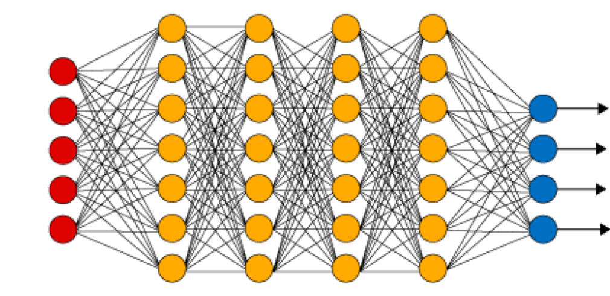
Neural Networks
How a computer sees
Notes:
https://medium.com/analytics-vidhya/what-is-cnn-a-5-year-old-guide-to-convolutional-neural-network-c9d0338c3bf7
https://becominghuman.ai/debunking-convolutional-neural-networks-cnn-with-practical-examples-688284c45b85

Slide 2
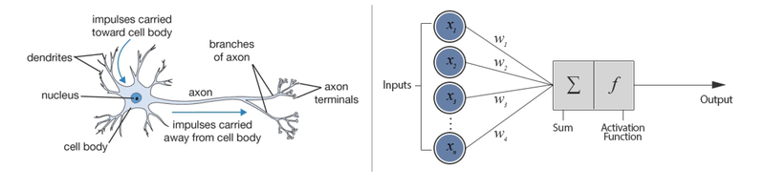
Why is it called neural network?
https://www.datacamp.com/community/tutorials/deep-learning-python

Slide 3
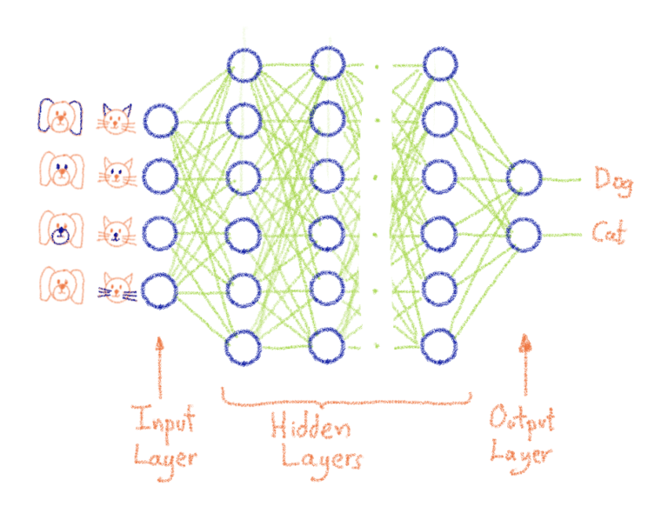

Neural Network
https://blog.ovhcloud.com/what-does-training-neural-networks-mean/
4
1
7
0

Slide 4

Convolutional Neural Network

Slide 5
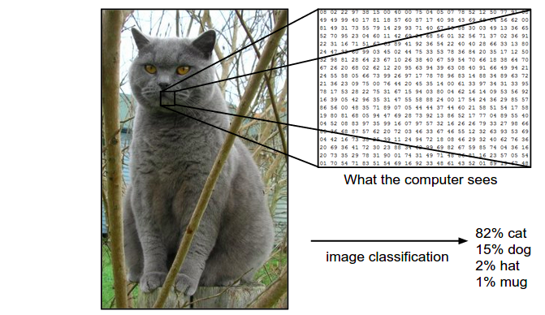
Convolutional Neural Network

Slide 6



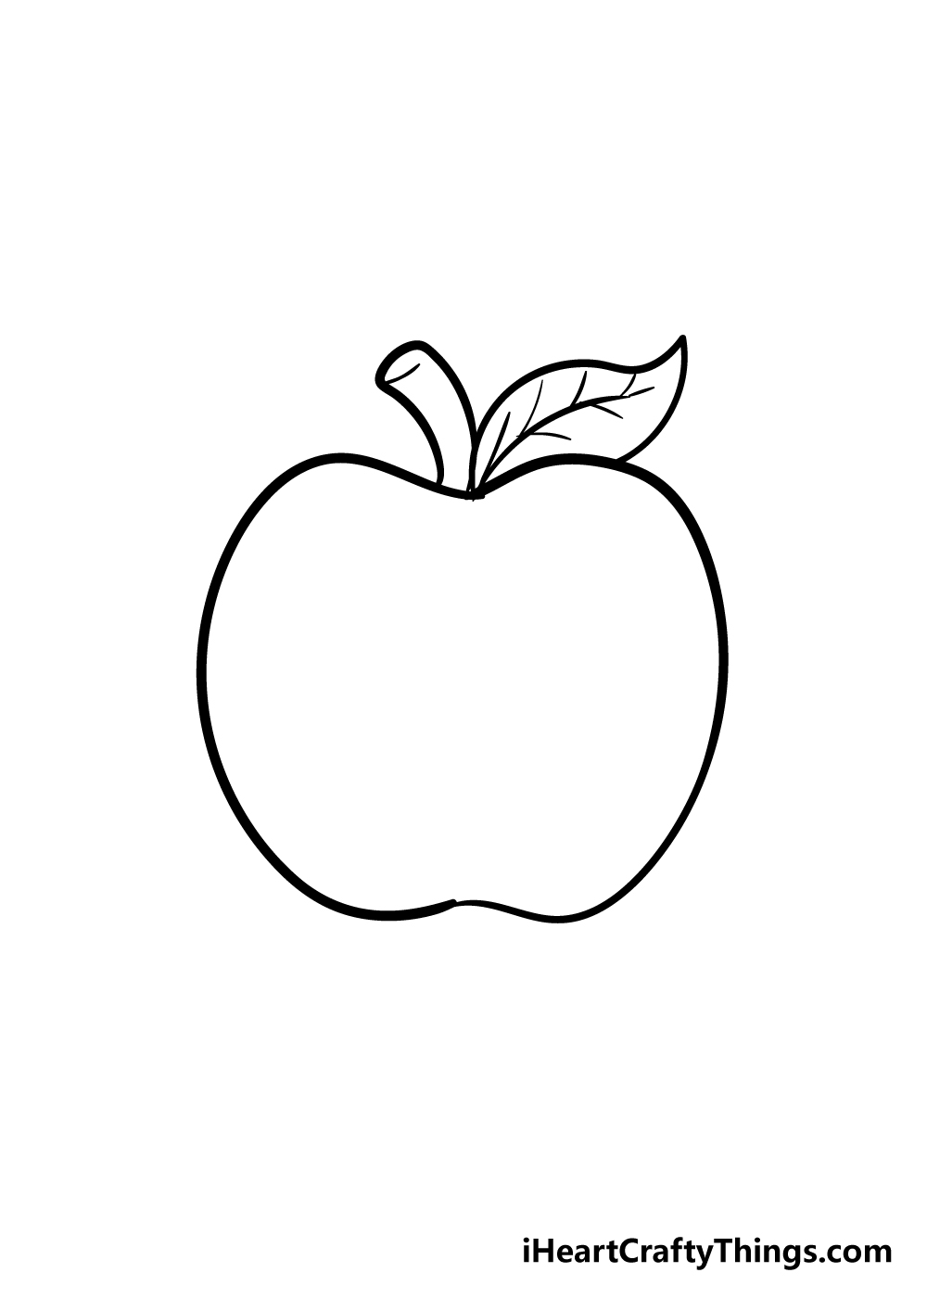
Image Classification
Awesome magic box
Cat
Label Assignment
Cat
Cake
Apple
…
Cake
Apple
We need to train a network first!
Training data (known data)

Slide 7

Image Classification
Awesome magic box
Cat
Label Assignment
Cat
Cake
Apple
…
Cake
Apple
What is this?
Training data (known data)
Testing data (new data)

Slide 8
Image Classification
I am 80% sure it is a cat.
Awesome magic box
Cat
Label Assignment
Cat
Cake
Apple
…
Cake
Apple
What is this?
Training data (known data)
Testing data (new data)

Slide 9
DEMO LINK
tinyurl.com/mydoodleit

Slide 10
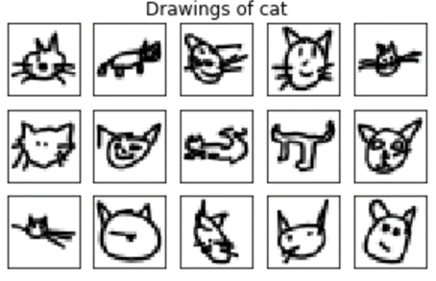
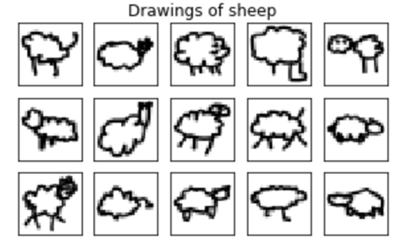
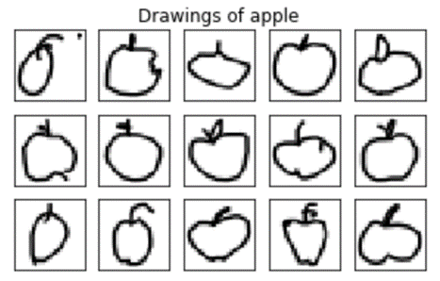
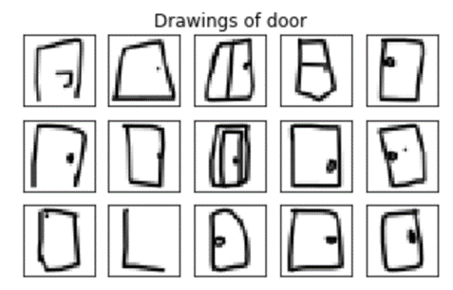
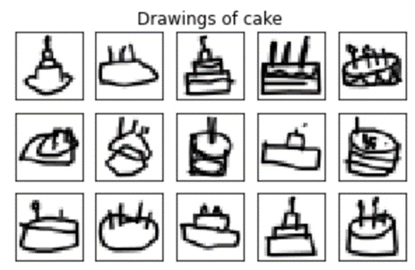
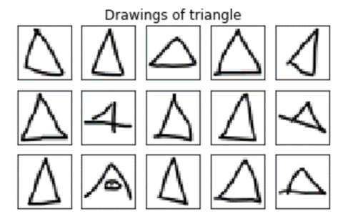
Training Data

Slide 11
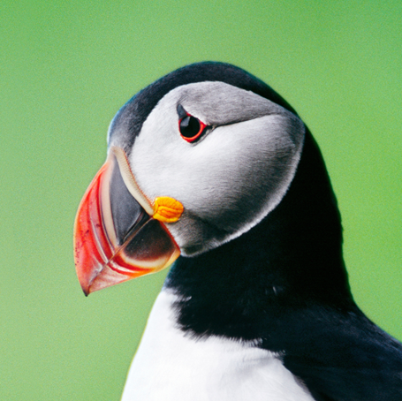

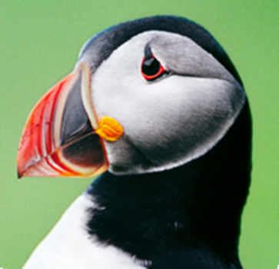
Image Recognition
What is more common in a picture?
Color
Edges
Are things in pictures always the same direction?

Slide 12
Convolutional Neural Network
2
4
1
7
0
…
1

Slide 13
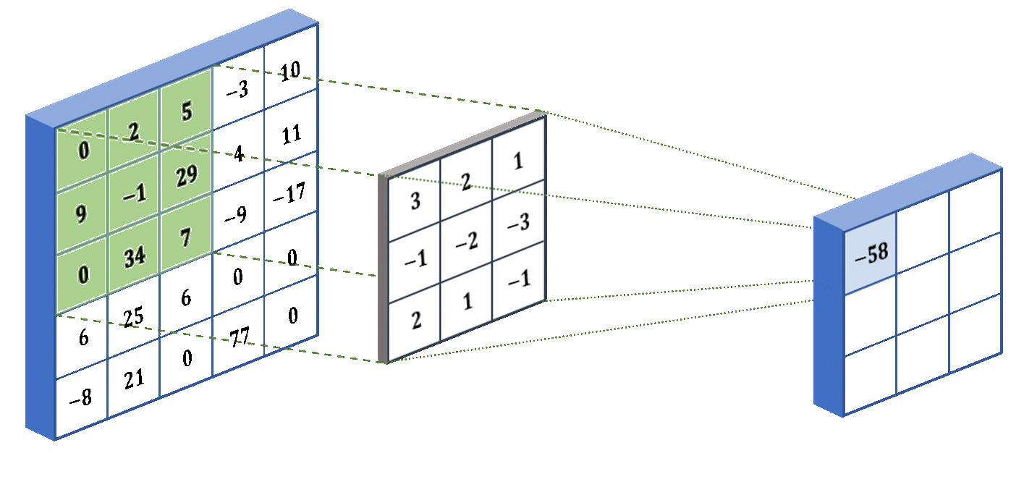
Kernel/Filter

Slide 14
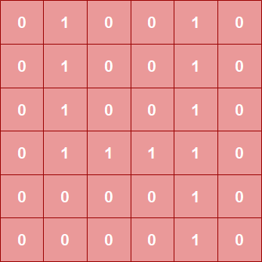
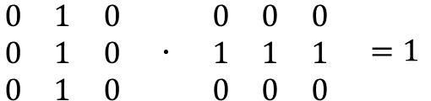
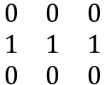
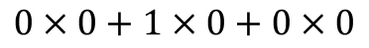
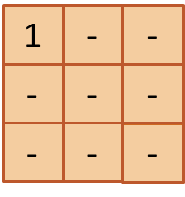
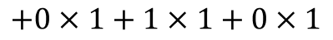
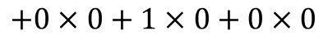
Kernel/Filter
Image
Kernel

Slide 15
Kernel/Filter
0
1
0
0
1
0
0
1
0
0
1
0
1
1
1
1
0
1
0
0
1
0
1
1
1
1
.
0
1
1
1
1
0
2
3
3
2
0
0
1
1
0
0
0
0
1
0
0
0
0
0
1
0

Slide 16
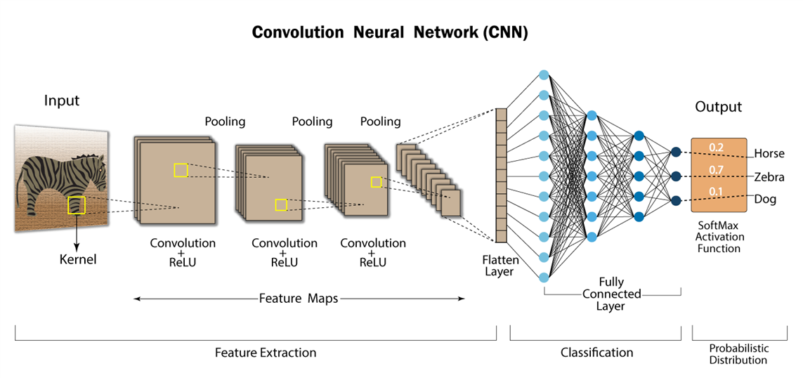
Then we feed the numbers into a network

Slide 17
Now it’s your turn
Turn a picture into numbers

Slide 18
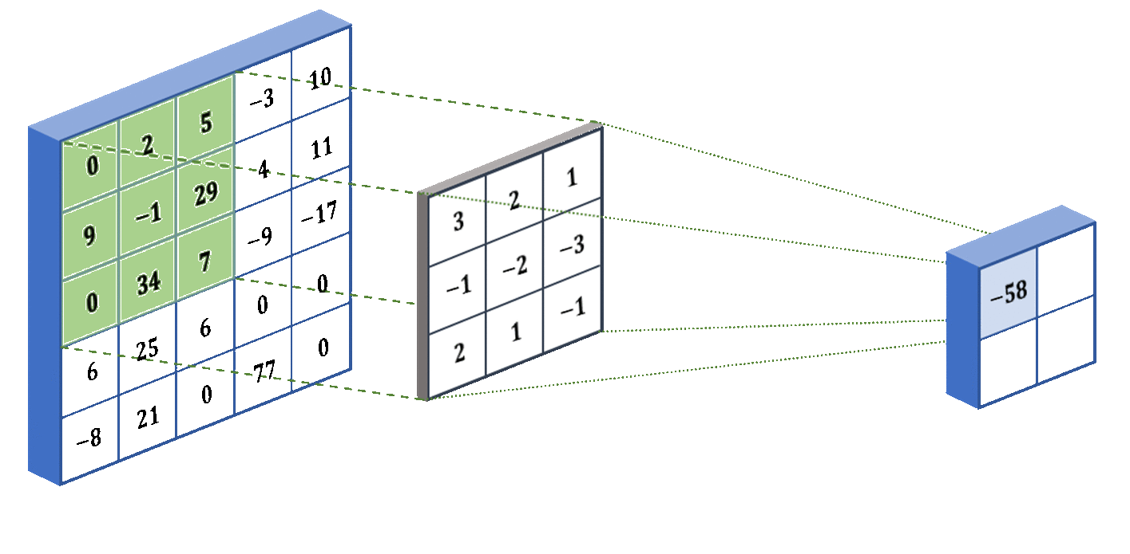
Pooling

Slide 19
Pooling
1
1
1
1
1
1
1
1
2
3
3
2
0
0
1
1
1
1
1
1
3
3
1
2
Max Pooling
Avg Pooling

